Slide 1
Advanced Data Science with Python
WKSP DSS420
Start 0900 EST
Notes:
Welcome to this Advanced level course on data science with Python. I’m your instructor __ and I’m glad to have you with me.

Slide 2
From Last Time
WKSP DSS220
Data Science Workflow
Python Environment Setup
Fundamentals of Python
Notes:
So you may have taken the precursors to this course, or you may already have familiarity with it.
In wksp 220, we covered the Data Science Workflow where you went through the 5 stages of starting, executing and finalizing a data science project.
We covered basics of data cleaning, used Decision trees and Random Forests, and some strategies for data visualization.
We also covered some fundamental instructions in Python, though it was not meant to be comprehensive.

Slide 3
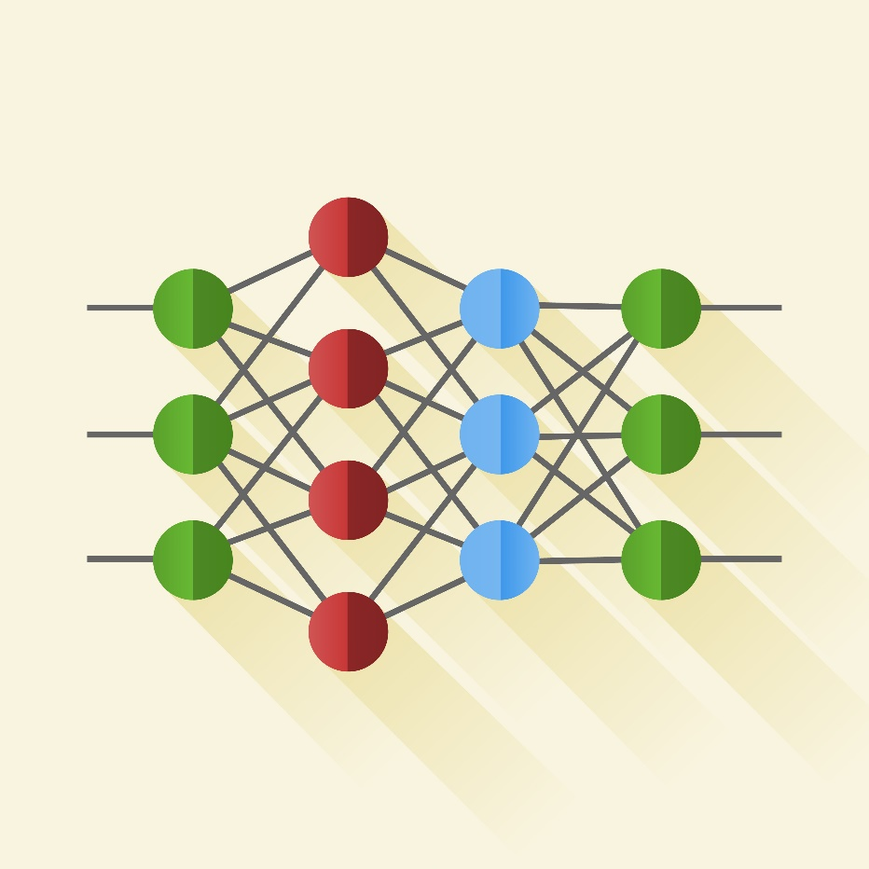
From Last Time
WKSP DSS320
Data Reduction and Expansion
Unsupervised Learning
Neural Networks
CNN
RNN
Notes:
Then in Workshop 320, the Intermediate Data Science course, we went over various Machine Learning methods.
We covered how to reduce and expand data when necessary. Then we went covered unsupervised learning where labels are not known beforehand and the machine needs to learn what groupings in the data might exist.
And we also learned about neural networks. How neurons are represented, how they are connected into networks, how to tune these networks for best performance. And then we went over 2 common types of neural networks – the Convolutional NN and the Recurrent NN.

Slide 4






Advanced Data Science
Recommender Systems
Reinforcement Learning
Natural Language Processing
Large Language Models (Transformers)
AI Ethics and Bias
Notes:
In this Advanced Data Science workshop, we’ll focus on application of data science. Specifically, we’ll cover some common algorithms that are used in a large variety of fields. I need to state that many people have gotten PhDs in even small portions of any of these topics. Here in this short continuing education course, we will therefore be covering general topics. My goal is for you to walk away with a general idea of how these applications work and when you should use them in your particular fields.
So that said, Let’s go over each of these one at a time.

Slide 5

Recommender Systems
Notes:
A popular use of Data Science is learning about user preferences and recommending something new that the user might like. This is nothing new because people we trust and experts often give us movie advice or trip recommendations. Now these AI systems try to do the same thing. We’ll explore how they determine two things are related and how these systems make their predictions.

Slide 6
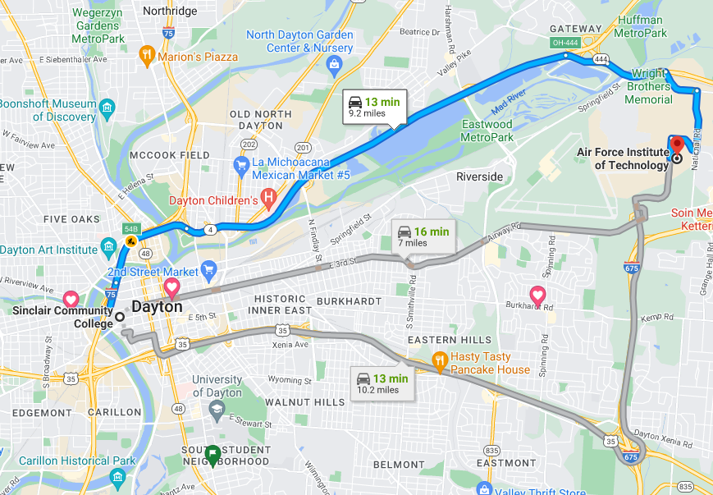
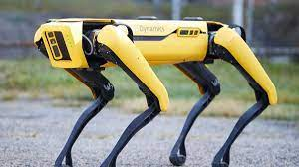
Reinforcement Learning
Notes:
Often we can’t train a model for every scenario with supervised learning, so we instead teach a system defined rules and identify a goal, and let the system learn how to get to the goal while following the rules. If you’ve seen route navigation software, or AI playing video games, or robots learning how to walk – all of these systems use reinforcement learning. It is a fundamentally different machine learning method than supervised and unsupervised learning.

Slide 7
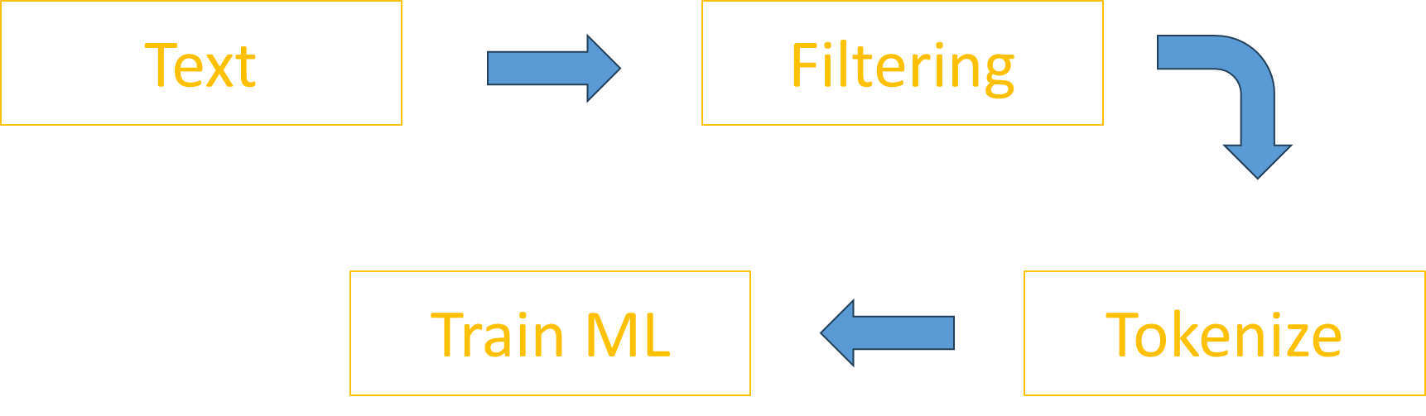
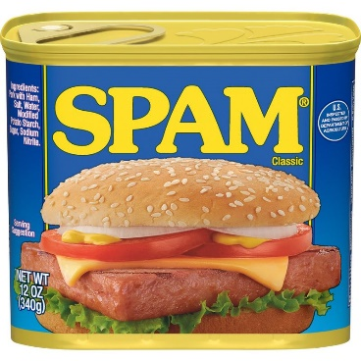
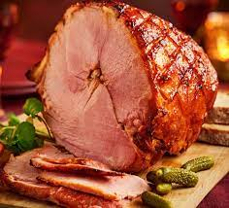
Natural Language Processing
Notes:
After that we’ll learn about Natural Language Processing. Like all of these concepts, these are huge fields of study and we’ll mainly be covering the core concepts. Particularly how to we convert text to number vectors in ways that vectors of similar words are also mathematically similar. We’ll also practice in the lab how identify spam and ham in text messages.

Slide 8
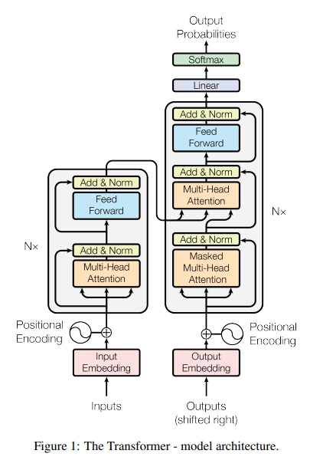
Transformers
Notes:
Then we’ll explore the concepts of how large language models work. These have been extremely popular during the time of this writing in 2023 so I wanted to include this because there are a lot of terms that are used a lot in research and applications that we should fundamentally understand. This is probably the most complex part of this course, but I’ve reduced the concepts to fundamentals, and provided references for those that want to explorer further.
In the lab we’ll practice using an open source repository and also see how to tune a transformer for your particular application.
We’ll end by briefly talking about other Generative AI methods and their practical uses.

Slide 9
Ethics and Bias in AI
Notes:
Finally, we’ll go over the most important topic of this course. We work in the Department of Defense, and all members of our force follow a strict code of ethics and conduct. It’s what differentiate us from other militaries in the world and it’s a key reason why we command so much respect from the public and the world. We follow this code in the Air, Sea, Land, Space and Cyberspace domains. So here we’ll discuss how to also follow ethical employment in the AI domain.

